Slide 1

Comparative Study of Leading Models For
Facial Mask Detection
Atharva Raut (ar2082), Rashi Rupchandani (rr1265), Dhanur Sharma (ds1987), Atharva Hiwarekar (aah202), Anuraag Kulkarni (ak2248), Priyanshu Shrivastava (ps1276)

Slide 2
Introduction
After recovering from a pandemic, being prepared for the next one is the need of the decade.
In the recent pandemic, we saw economies failing due to a ban on gathering in large numbers, that deterred the supply chains.
As we recover, we find it necessary to gather together in groups with proper precautions. One of the important precautions is wearing a mask.
Though this precaution can be enforced manually, it requires a large workforce. Having such a large workforce is not viable in all situations.
Thus, there is a need to detect whether any individual in a crowd is not wearing a mask.

Slide 3
Problem Statement
The problem of mask detection amongst large number of people is an old one and needs to be solved using state-of-the-art models. (The issue of identifying mask compliance within a sizable crowd has been a longstanding challenge that calls for cutting-edge models to address.)
YOLOv7 published in 2022 are in the forefront of real-time object detection.
There is a need to benchmark this model against the other leading models.
We will be comparing the same with the following models to check performance for face mask detection -
1. YOLOv7
2. GRCNN (Detectron2)
3. RetinaNet

Slide 4
Dataset
Here, we would be using the Face Mask dataset.
This dataset contains 853 RGB images of individuals and multiple groups of people belonging to 3 classes viz. -
Wearing a mask
Not wearing a mask
Wearing mask incorrectly

Slide 5
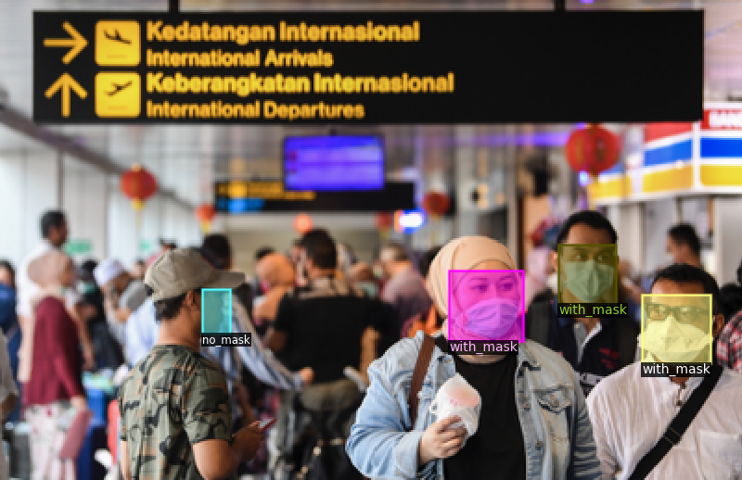
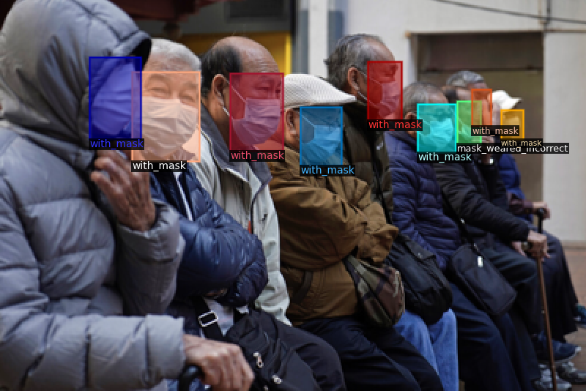
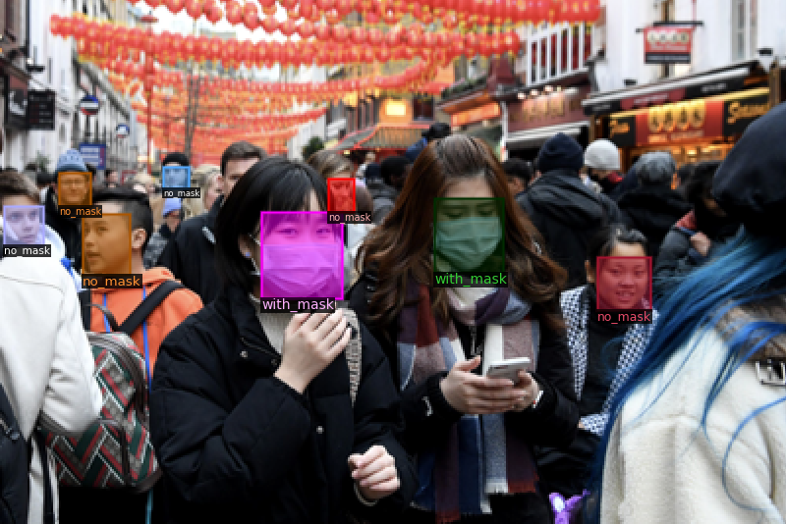
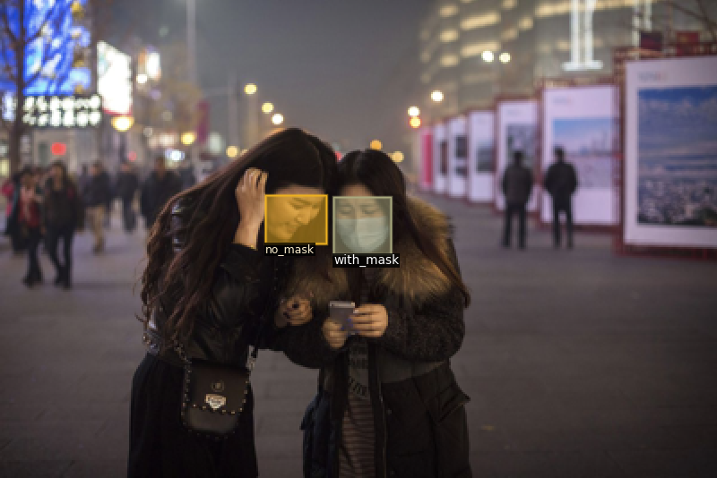
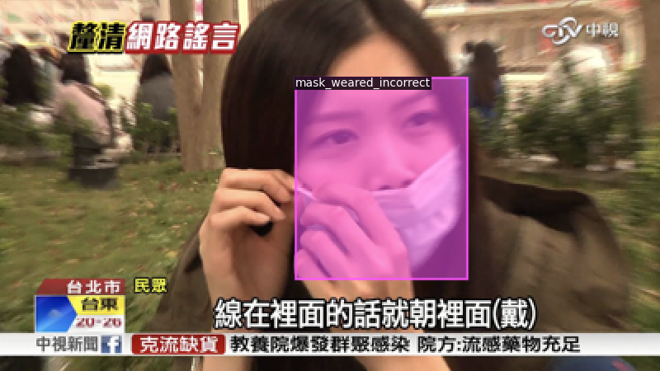

Slide 6
Pre-processing
Since we will be comparing the 3 models on the same dataset, ensuring the fairness of the additional training is of paramount importance.
To ensure that, we will be splitting the dataset into training and testing sets consistently for all models to be trained and tested upon.
This is achieved through using a seed in the split function.

Slide 7
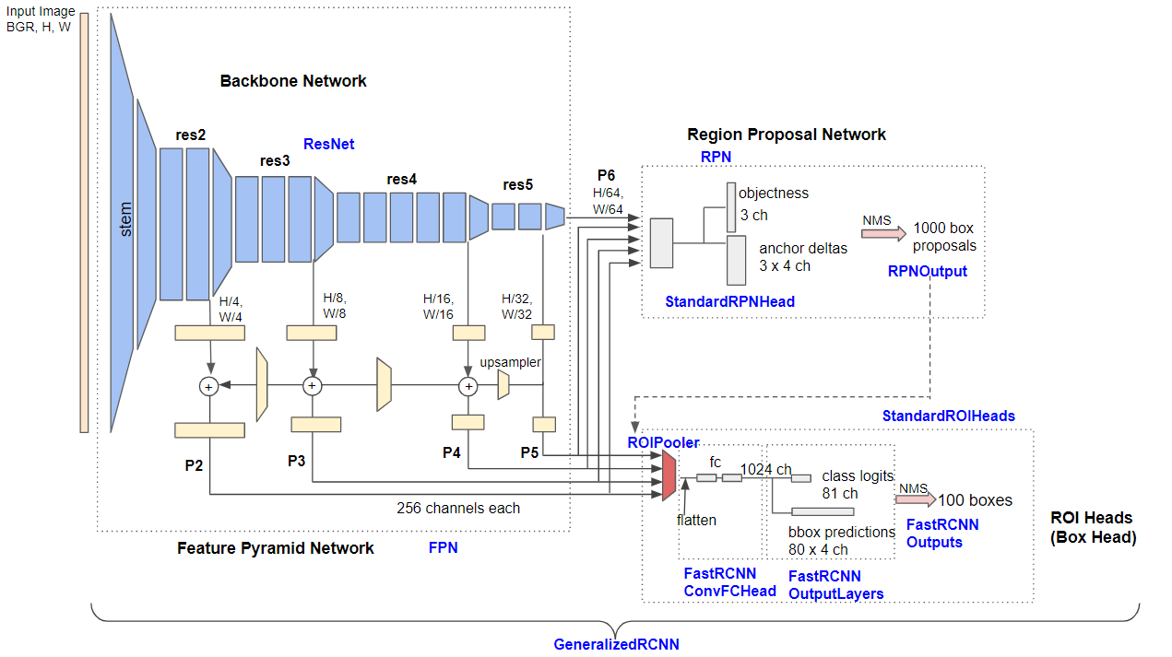
Detectron2 Framework Architecture
Backbone:
Backbone of the model is a ResNet network with a Feature Pyramid Network (FPN) attached to it.
The ResNet network serves as a feature extractor, extracting meaningful features from the input image.
The FPN network is used to combine features from multiple levels of the ResNet network, to allow the model to detect objects at different scales.

Slide 8
RPN:
ROI Heads:
Takes the feature pyramid produced by the backbone and generates region proposals.
It is composed of two fully connected layers that produce a set of objectness scores and bounding box regression offsets for each anchor box at each spatial location in the feature pyramid.
The RPN uses these anchor boxes to generate region proposals.
It is responsible for taking the feature map generated by the RoI pooler and using it to classify and localize objects within the region of interest.
It consists of two fully connected layers: a box classifier and a box regressor.
The box classifier takes the RoI feature map as input and outputs a probability distribution over the classes of objects present in the RoI.
The box regressor takes the same input and outputs a set of four numbers representing the predicted offsets of the bounding box enclosing the object.

Slide 9
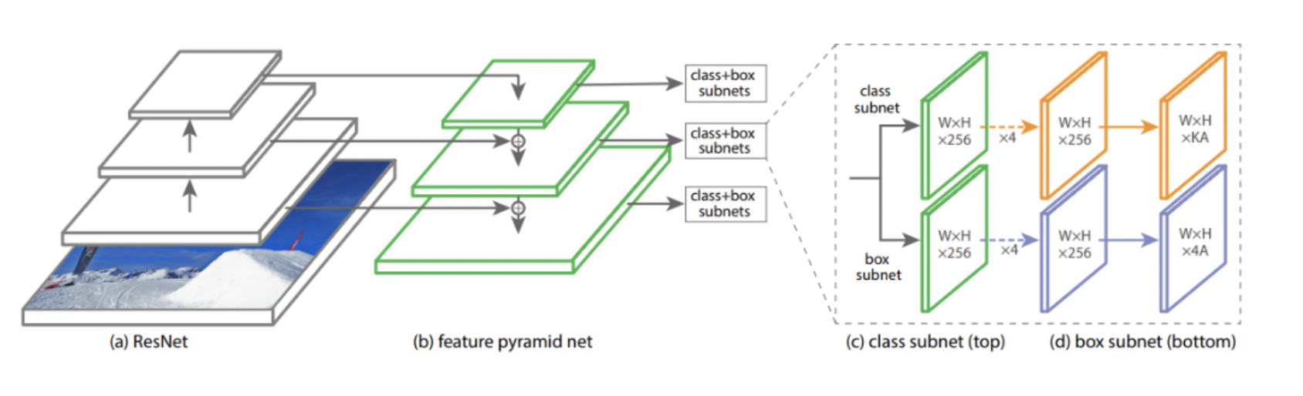
RetinaNet
RetinaNet makes two improvements over existing single stage object detection models - Feature Pyramid Networks (FPN) [1] and Focal Loss [2].
ResNet is used for deep feature extraction.
Feature Pyramid Network (FPN) is used on top of ResNet for constructing a rich multi-scale feature pyramid from one single resolution input image. FPN is multiscale, semantically strong at all scales, and fast to compute.
Classification subnetwork predicts the probability of an object being present at each spatial location for each anchor box and object class.
Regression subnetwork regresses the offset for the bounding boxes from the anchor boxes for each ground-truth object.
RetinaNet Architecture

Slide 10
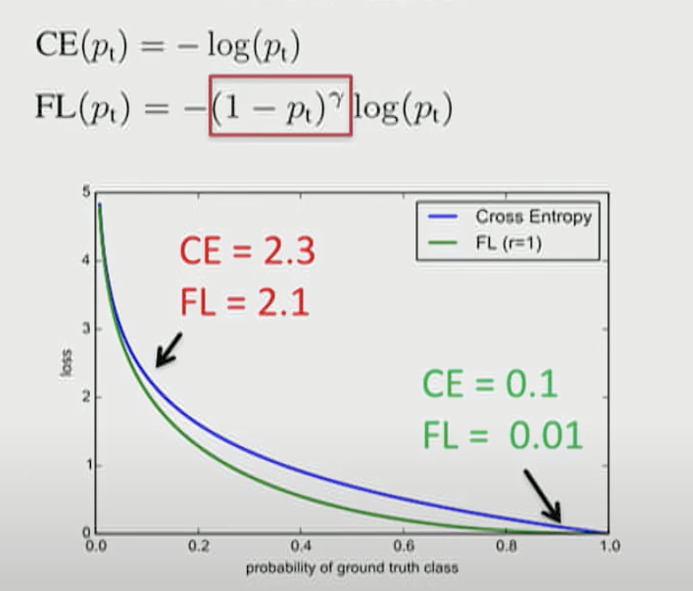
RetinaNet
Focal Loss
Focal Loss (FL) is an enhancement over Cross-Entropy Loss (CE) and is introduced to handle the class imbalance problem with single-stage object detection models.

Slide 11
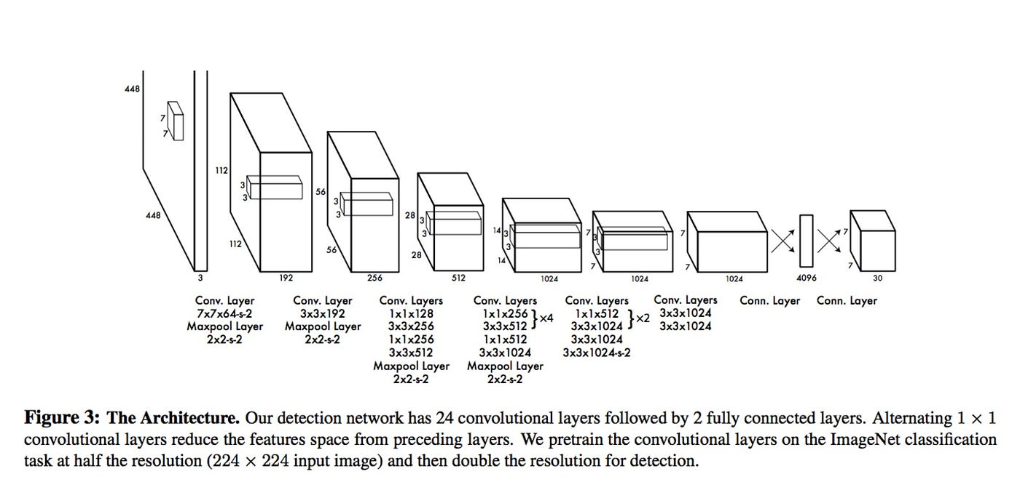
YOLO Architecture
It frames Object detection as a Single Regression problem.
YOLO has 24 convolutional layers, four max-pooling layers, and two fully connected layers.
Its trained on ImageNet 1000 class dataset.
Algorithm is based on the following approaches:
Residual blocks
Bounding box regression
Intersection over Union
Non-max suppression

Slide 12
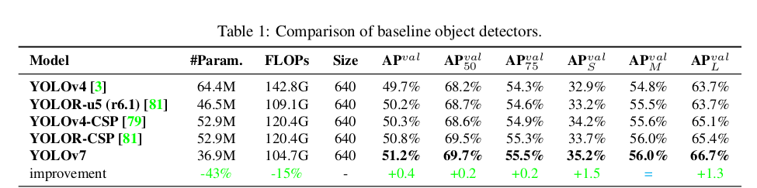
YOLOv7 Model Specifications
YOLOv7 uses E-ELAN architecture that enables it to learn better by using the expand-shuffle-merge cardinality.
It uses Compound model scaling which allows it to maintain the properties the model had at initial design.
In YOLOv7, the architecture of planned re-parameterized convolution uses RepConv without identity connection (RepConvN).
The YOLO v7 algorithm achieves the highest accuracy among all other real-time object detection models.

Slide 13
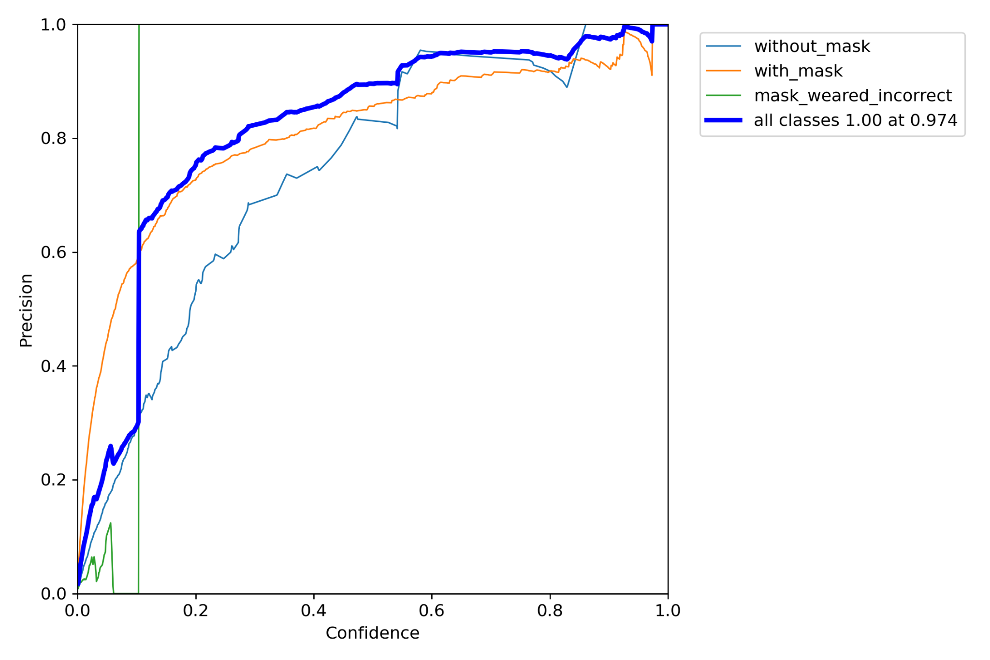
YOLOv7 Performance – Precision vs Confidence Score

Slide 14
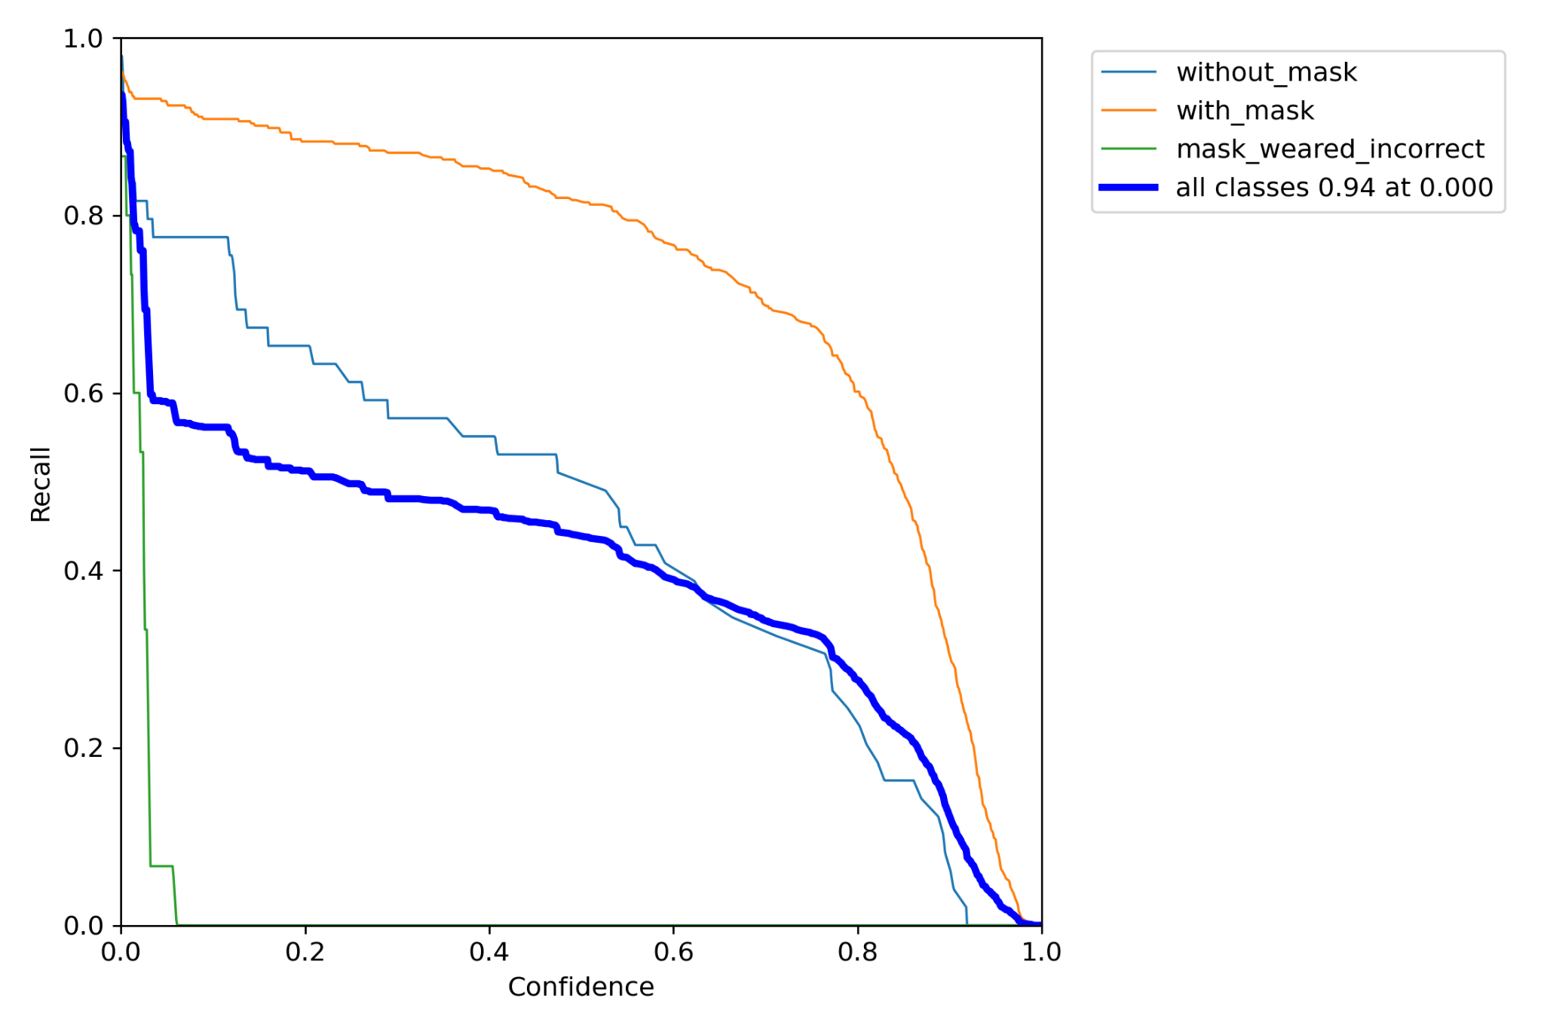
YOLOv7 Performance – Recall vs Confidence Score

Slide 15
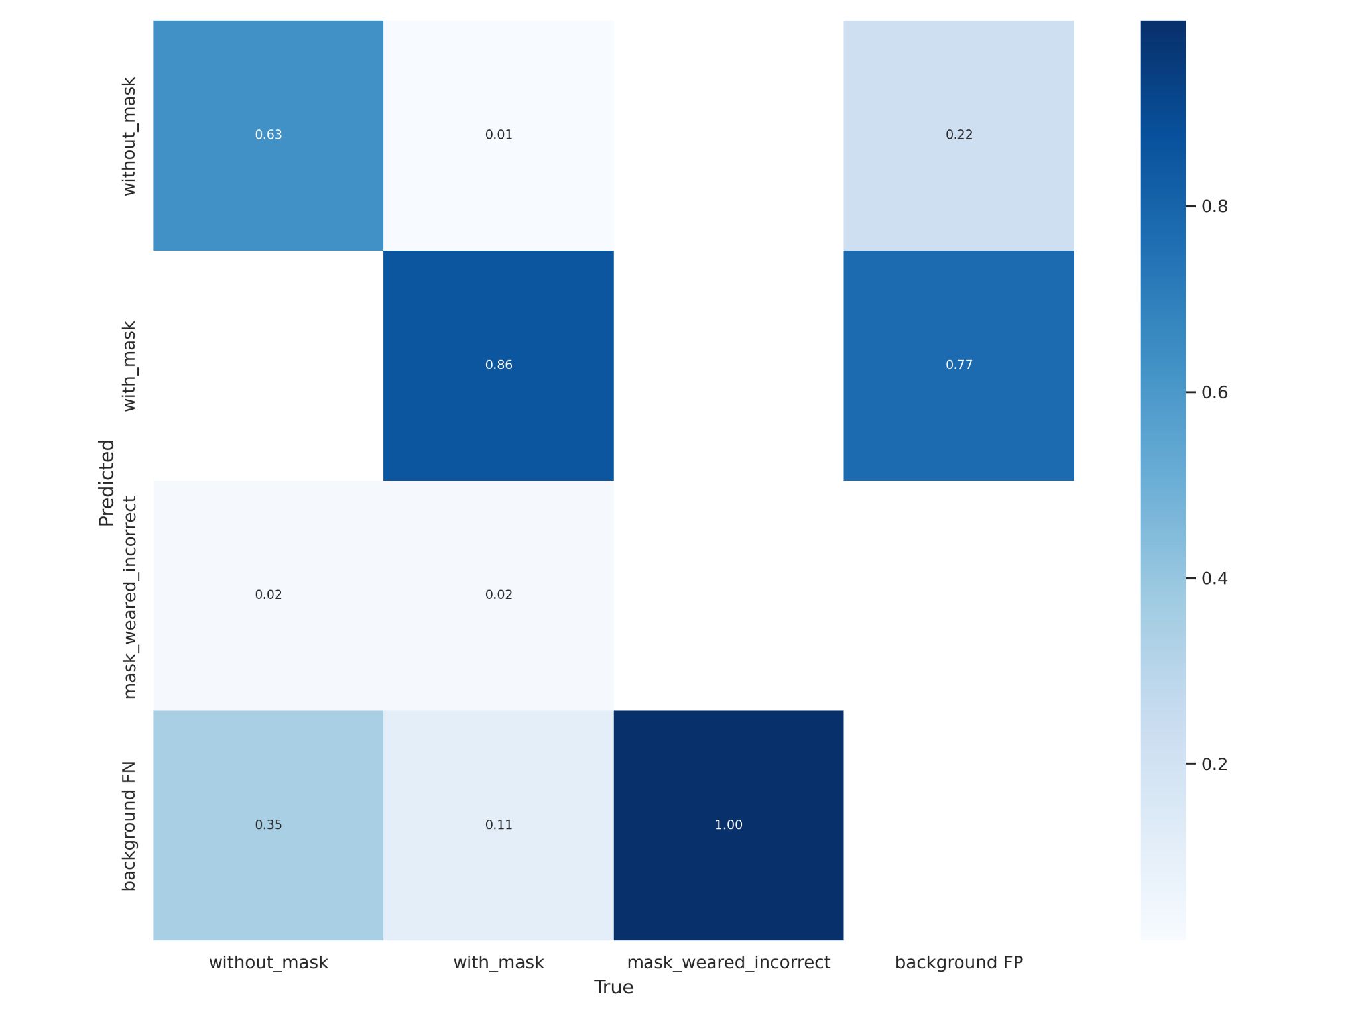
YOLOv7 Performance – Confidence Matrix

Slide 16
Parameters
Precision : (# of true positives) / (# of true positives + # of false positives)
Recall : (# of true positives) / (# of true positives + # of false negatives)
Loss : The delta between the values predicted by the model and the actual values

Slide 17
Comparative Study
Yolov7 is ideal for this use case as it has high precision and fast inference speed. This makes it suitable for real-time scenarios.
Parameter | Detectron2 | RetinaNet | YoloV7
Precision | 0.64 | 0.75 | 0.895
Recall | 0.67 | 0.69 | 0.451
Loss | 0.44 | 0.23 | 0.051

Slide 18
References
Dataset: https://www.kaggle.com/datasets/andrewmvd/face-mask-detection
YOLOv7: Joseph Redmon, Santosh Divvala, Ross Girshick and Ali Farhadi. (2016). You Only Look Once: Unified,Real-Time Object Detection. IEEE Conference on Computer Vision and Pattern Recognition, 1-10.
Faster R-CNN (Detectron-2): Shaoqing Ren, Kaiming He, Ross Girshick, and Jian Sun. (2017). Faster R-CNN: Towards Real-TimeObject Detection with Region Proposal Networks. IEEE Transactions on Pattern Analysis and MachineIntelligence, 39:1-14.
RetinaNet: [1] Tsung-Yi Lin, Piotr Dollár, Ross Girshick, Kaiming He, Bharath Hariharan: “Feature Pyramid Networks for Object Detection”, 2016; [http://arxiv.org/abs/1612.03144 arXiv:1612.03144]. [2] Tsung-Yi Lin, Priya Goyal, Ross Girshick, Kaiming He: “Focal Loss for Dense Object Detection”, 2017; [http://arxiv.org/abs/1708.02002 arXiv:1708.02002].

Slide 19
THANK YOU

